Slide 1
Introduction to Xbank
By Deepti Gaur

Slide 2
A simple step by step guide to work with xbank software.
Step 1. Login : By giving User Name and Password.
Step 2. Understand one by one Tab
Step 3. Add Member
Step 4. Create SM Account
Step 5. Do other operation

Slide 3
As a xbank User , you can use it and perform any operations that are as follows:
Create & Access account information
Transfer funds
Review and pay bills
Check the Cheque status,(Find out if a cheque was cleared)
Find out any type of Dues
Apply for Loan
Search for the Schemes
Check insurance policies, prices & updates.
Generate any type of Reports

Slide 4
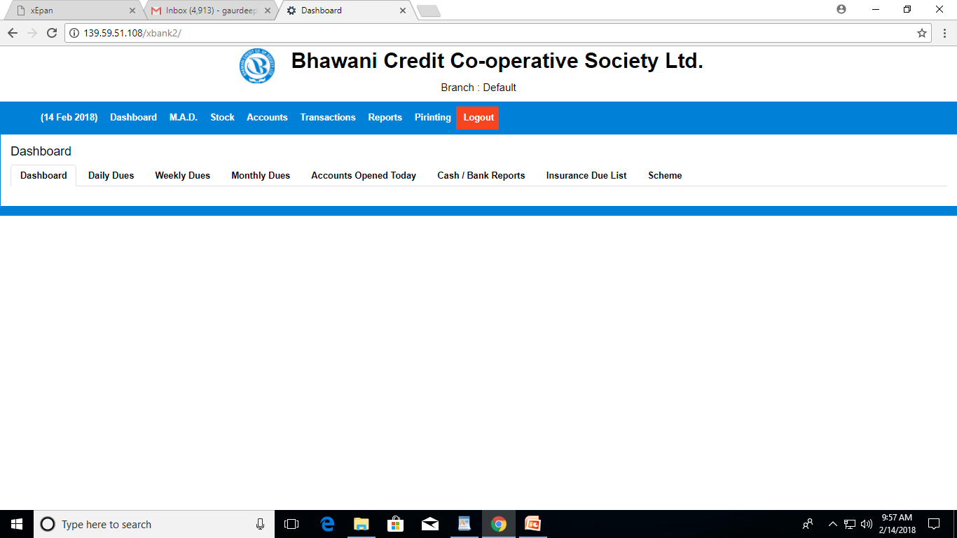
Getting Start : To get start with xbank , first user need to login by user name & password, then following screen will display

